Slide 1

CityJSON to Revit
A Plugin for Autodesk Revit
Amir Hakim
S.Hakim@tudelft.nl

Slide 2
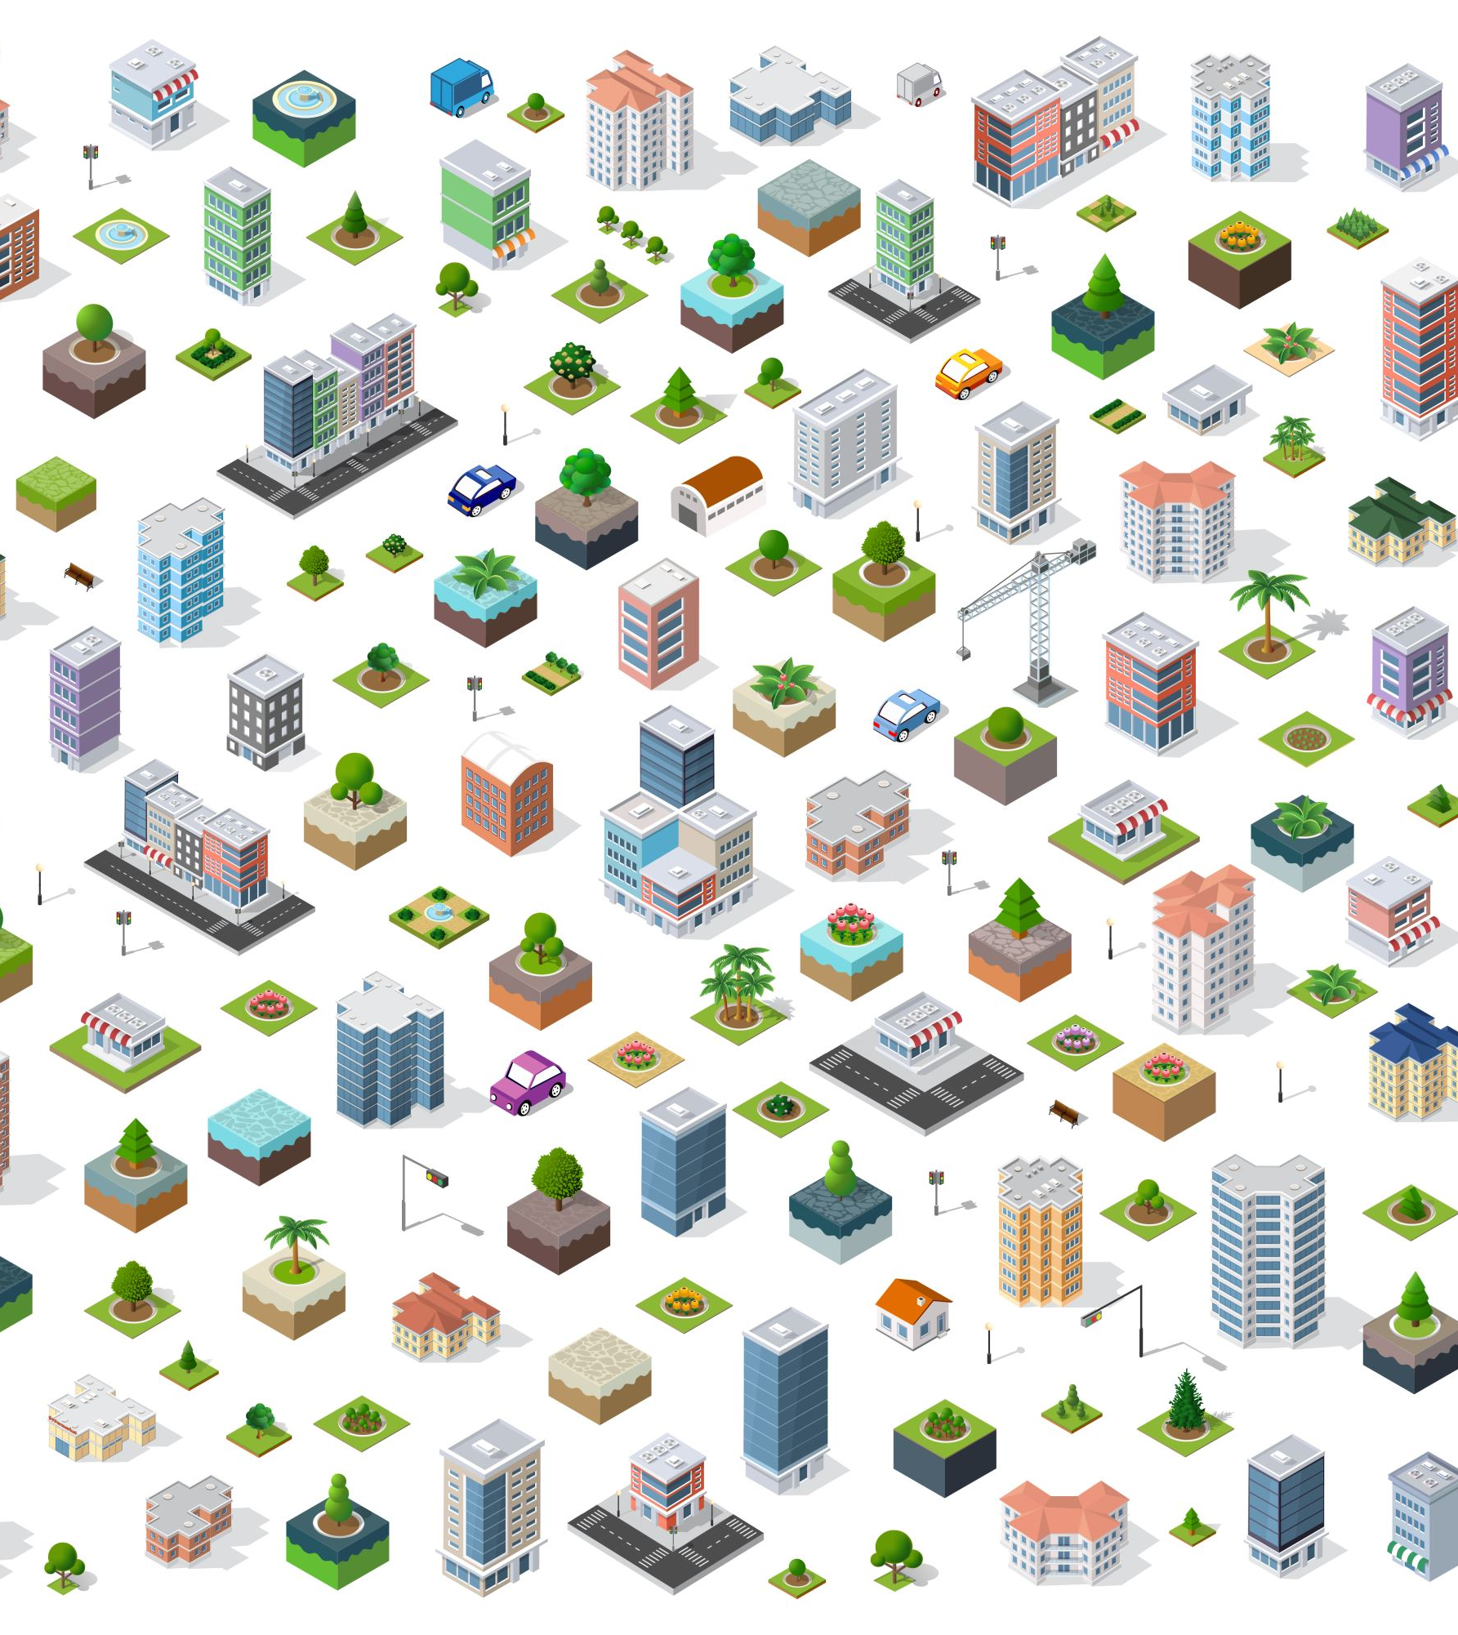
Visualizing CityJSON geometries in Revit
Most of the exiting solutions make all the geometries as one object
Ability to see how eliminating or changing city objects affects the BIM model

Slide 3

CityJSON
a data exchange format for digital 3D models of cities and landscapes
It aims at being easy-to-use (for reading, processing, and creating datasets)
It was designed with programmers in mind, so that tools and APIs supporting it can be quickly built.

Slide 4
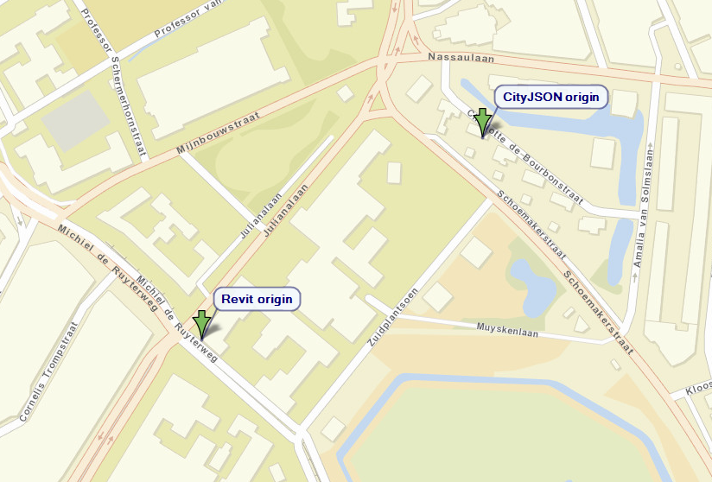
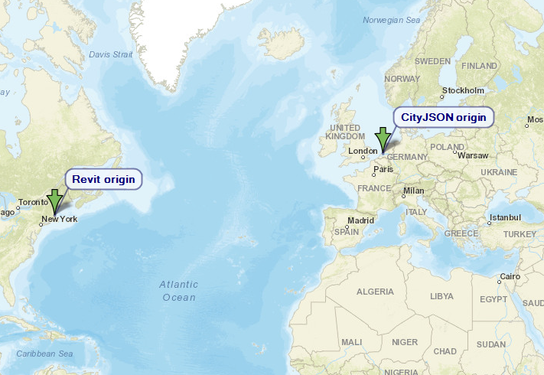
CityJSON origin vs. Revit origin
Notes:
Not assigned by the user/ problem of having far objects from origin making graphics problem

Slide 5
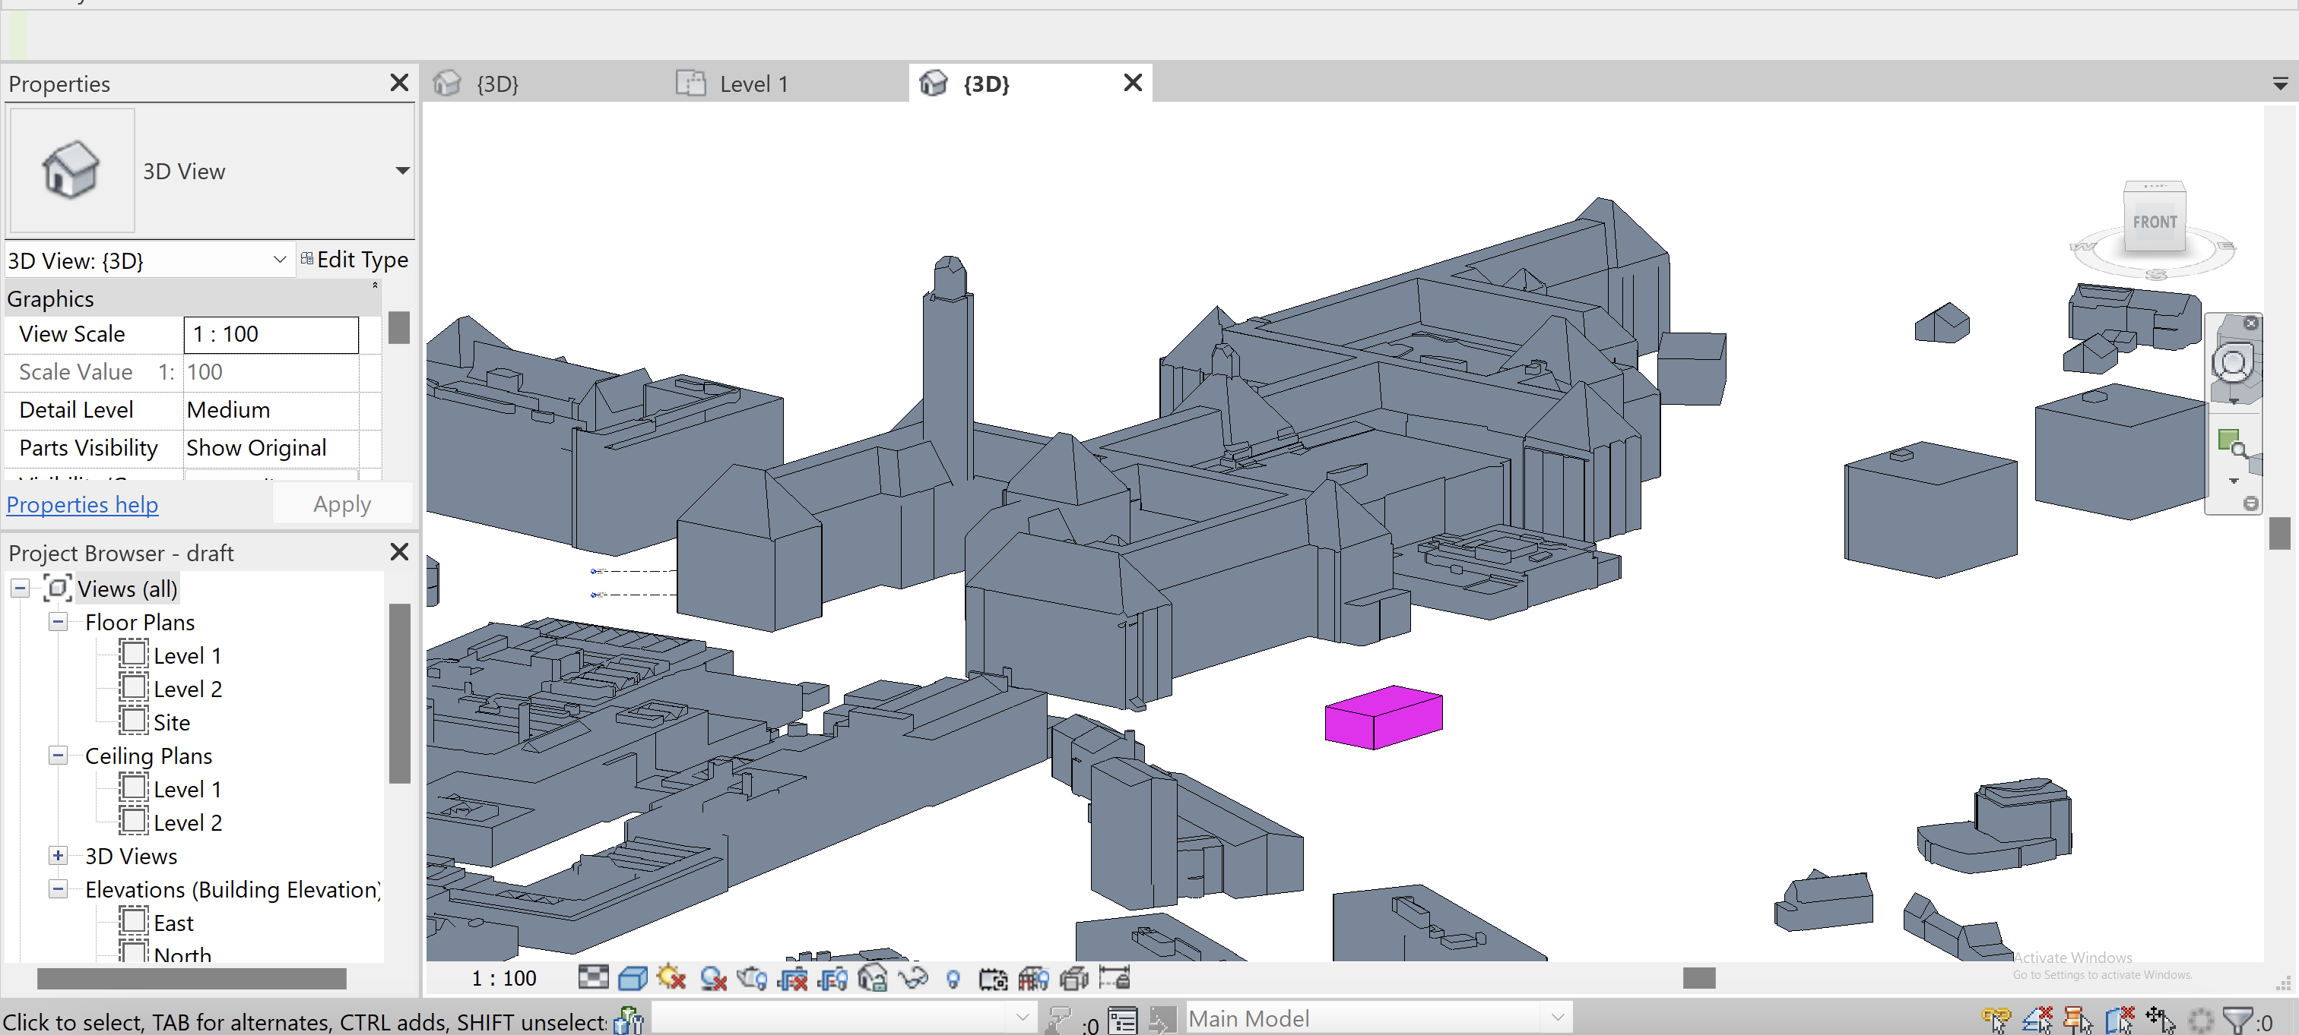
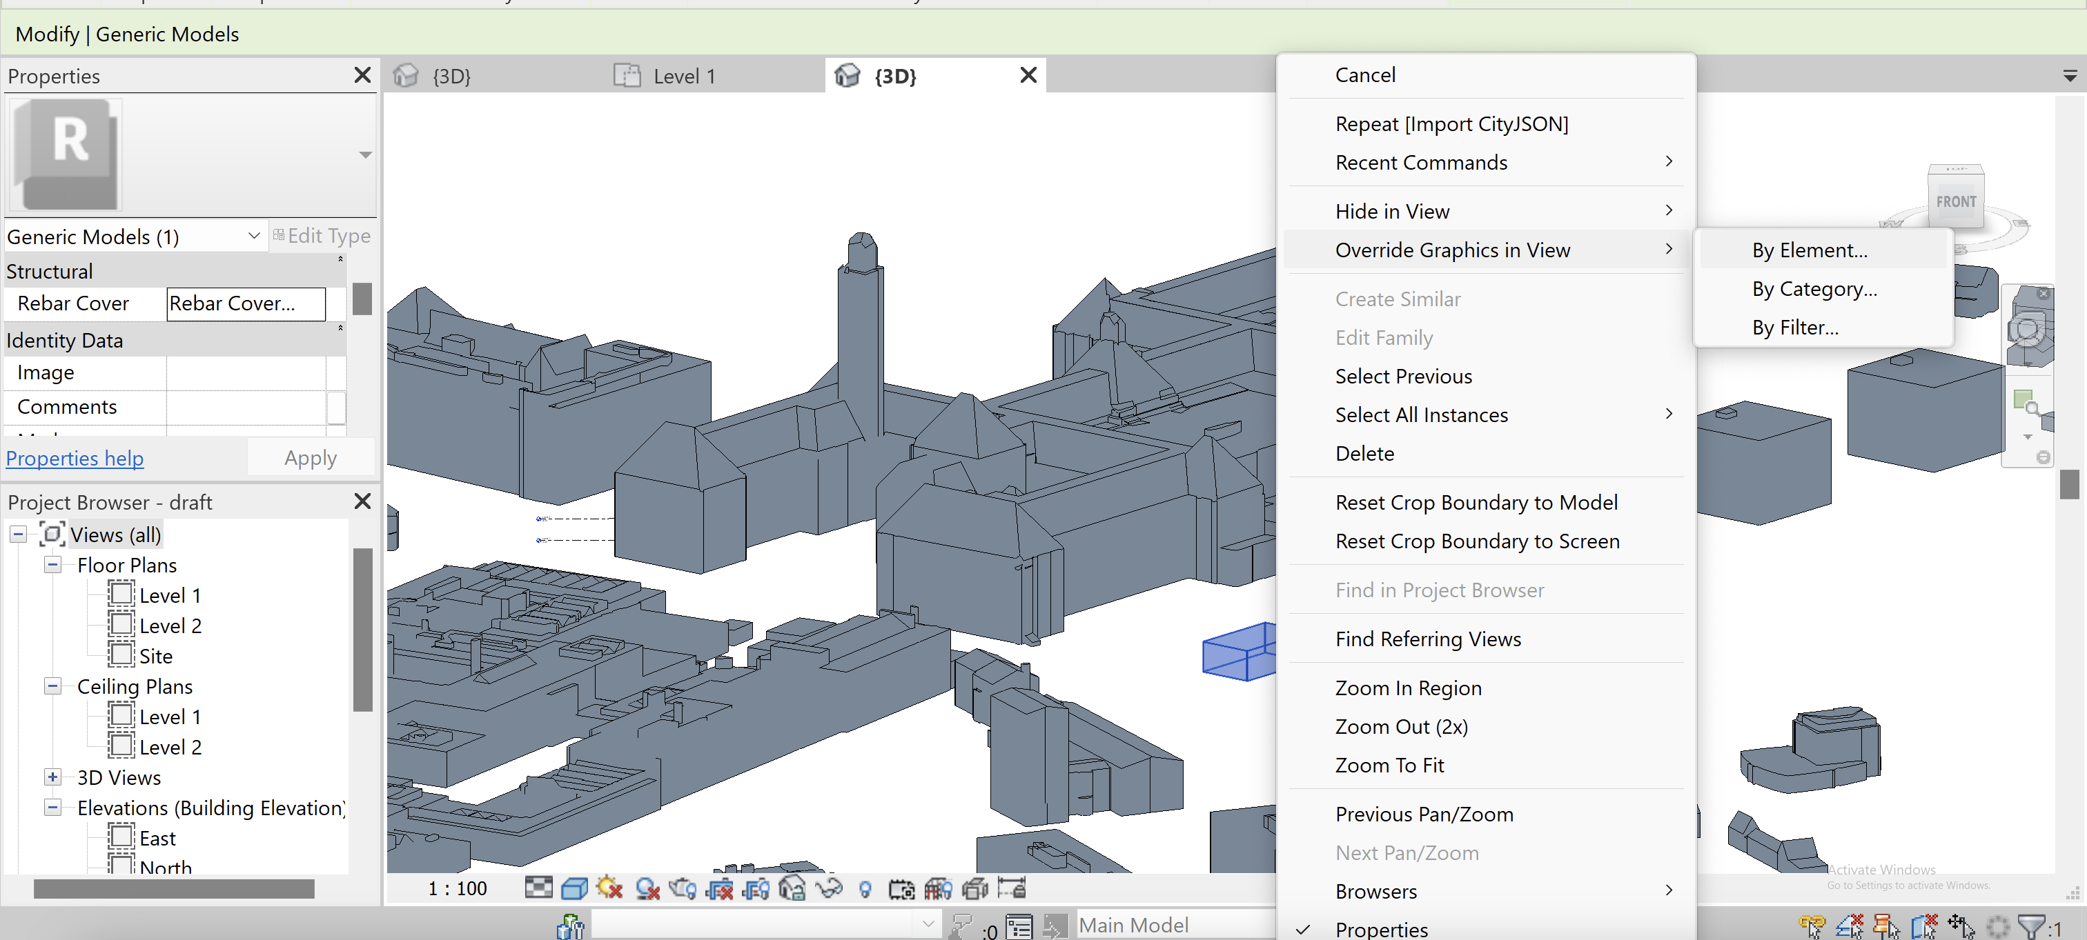
Visualizing objects in Revit
Color override in views
Notes:
Good solution for one view recognition

Slide 6
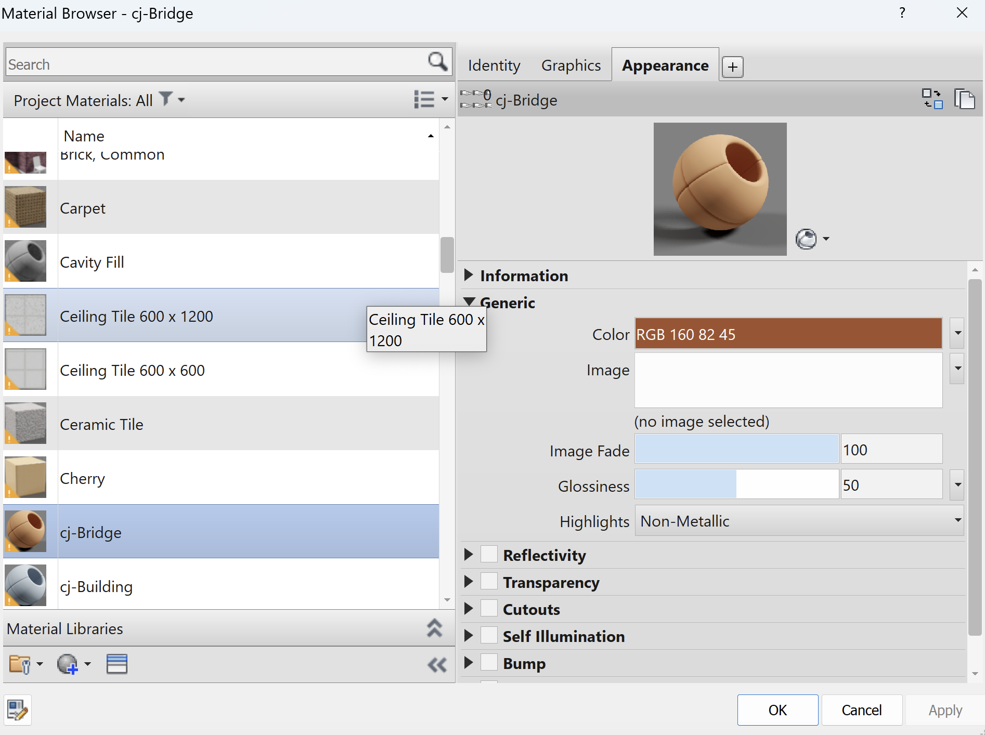
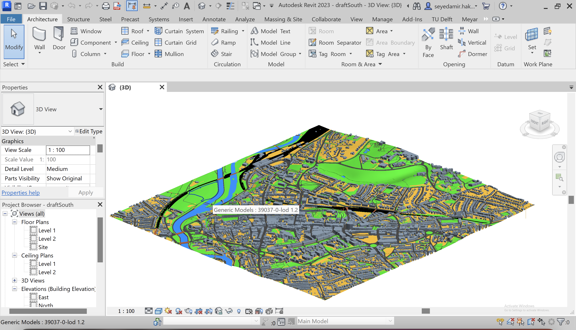
Visualizing objects in Revit
Material assignment

Slide 7
Target
First version will be published in the official Autodesk App Store as a free plugin.
The repository is available publicly on GitHub

Slide 8
Future updates
Adding CityJSON toolbar for searching and reading geo-object details and semantics

Slide 9
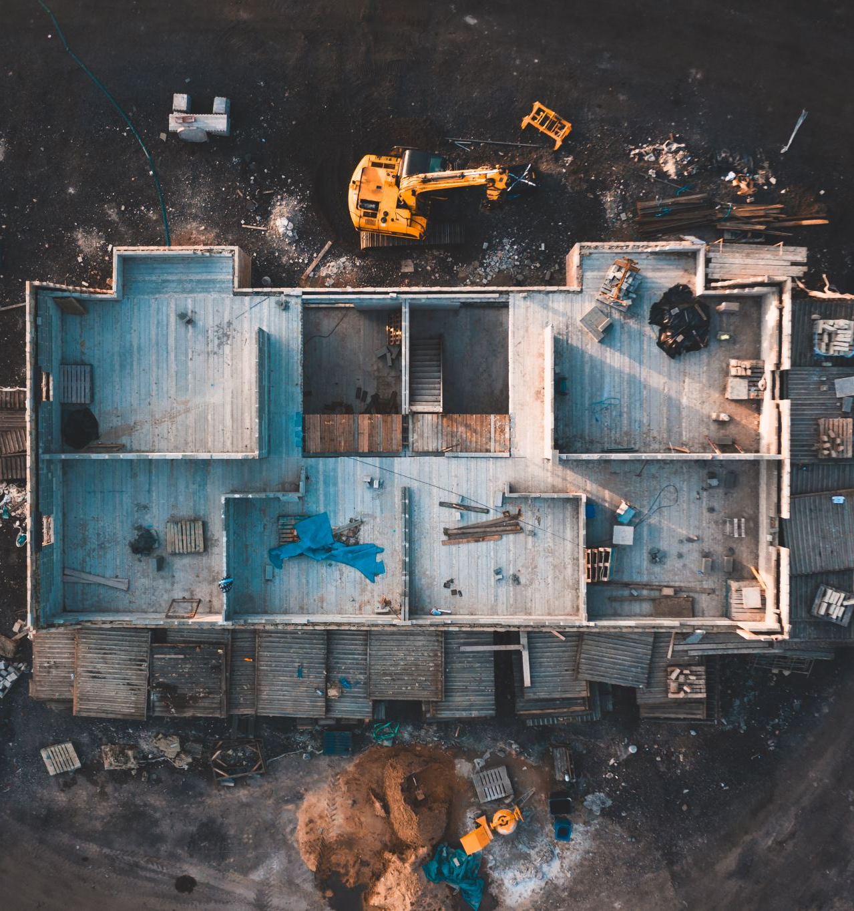

Questions?
What would be possible use of this plugin in AEC?
Which updates can be considered for the future version?

Slide 10

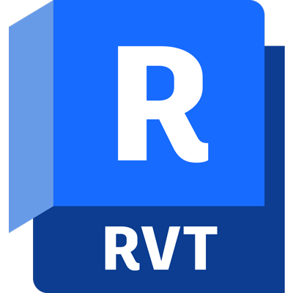

Thank you!

