Slide 2

RhinoCityJSON
Rhino/Grasshopper plugin allowing the CityJSON format to be directly used in Rhino 3D and grasshopper
Jasper van der Vaart / 17-11-2022
Notes:
Hello, I am Jasper van der Vaart, A developer and researcher at the TU Delft. And for the last couple of weeks, I have been working on the development of the RhinoCityJSON plugin. This is a grasshopper plugin that allows for easy and quick importing of CityJSON data into Rhino 3D. We are not only talking about geometry, but also the attributes and other semantic data.
For the people that are unfamiliar with Rhino or Grasshopper, Rhino is a 3D modelling environment similar to SketchUp, but allows for a lot more advanced modelling options. Of which some are enabled by grasshopper, which is an application that allows the creation of models and data via a visual programming language.

Slide 3
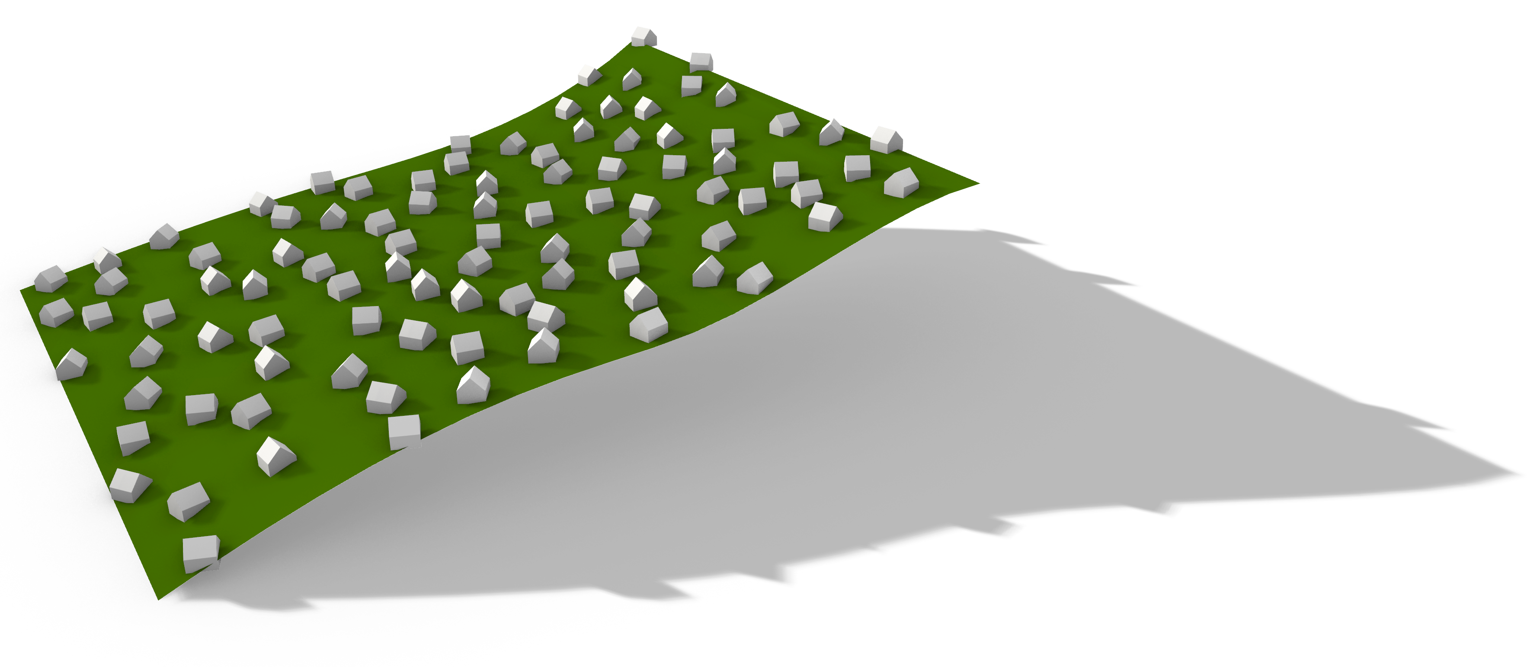
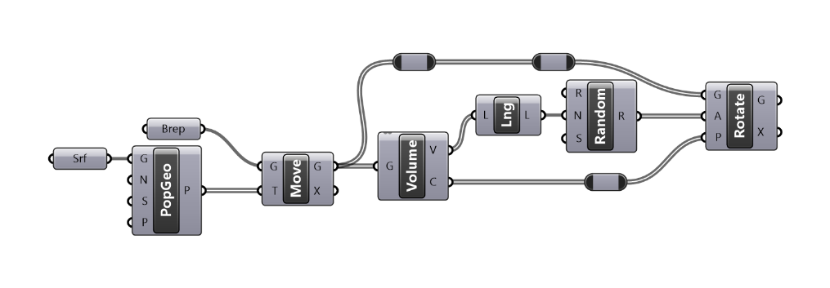
Why Grasshopper?
09-10-2022
Notes:
So why a plugin for grasshopper? And not a more popular modelling software package? Well, the answer to that is very straightforward. Grasshopper grands incredible flexibility and power to a user without the need of any in depth programming knowledge. For example, populating an undulating surface with randomly rotated houses is extremely easy and can be done by connecting a couple of simple to understand components. Grasshoppers’ granted simplicity was also kept in mind while developing the RhinoCityJSON plugin. The easiest processes can be done with a very easy script, while step by step scripts can be made more complex to allow for more advanced operations.

Slide 4
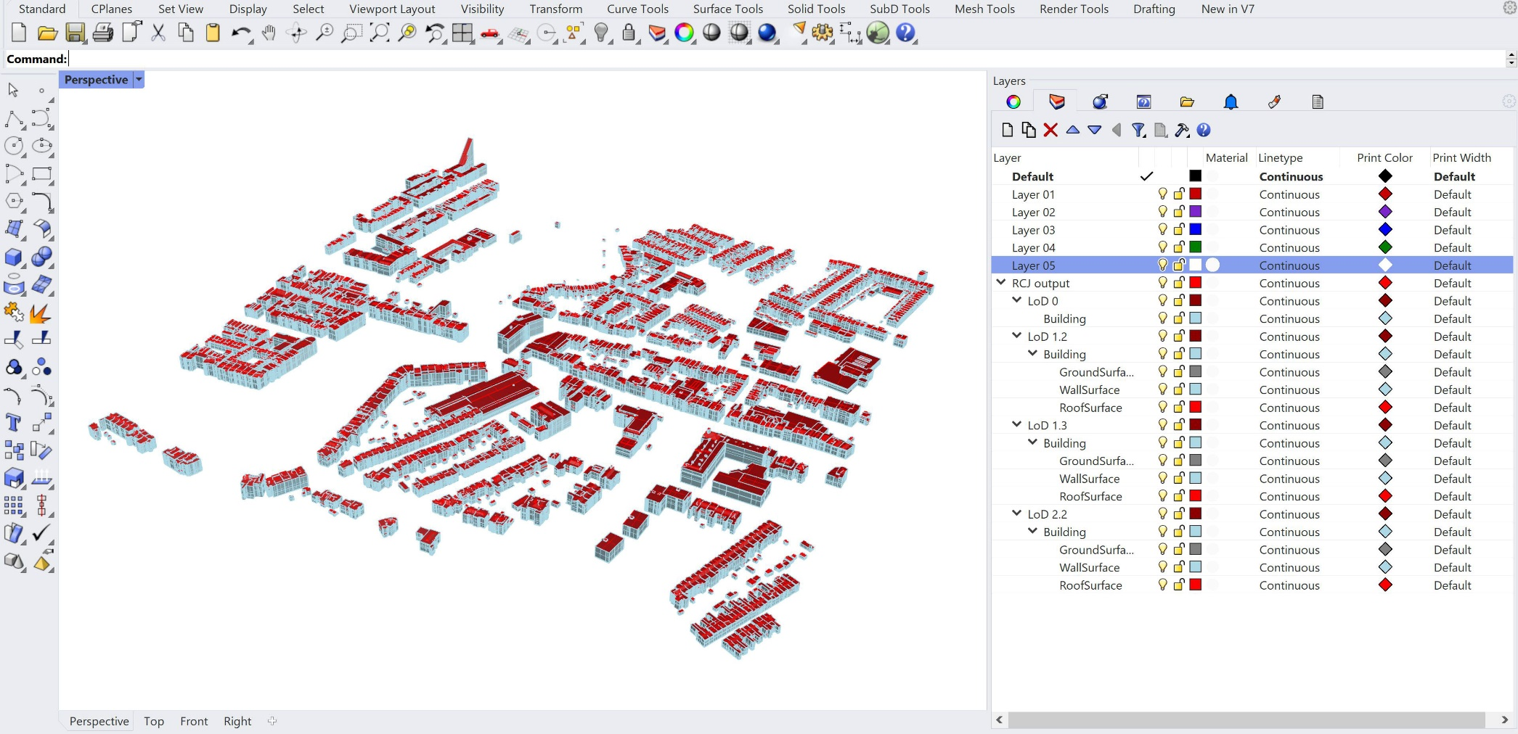
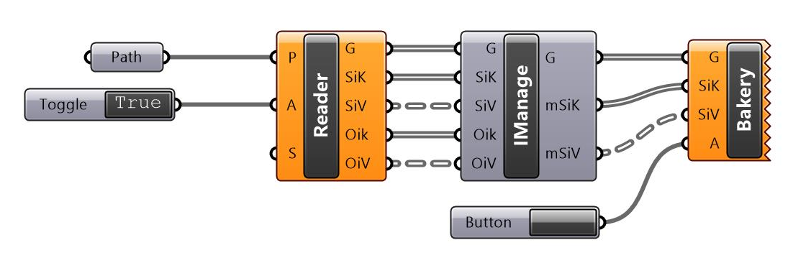
Basic Scripting
09-10-2022
Notes:
So, lets take a look at one of the most basic executions, the actual import of CityJSON data to Rhino3D. With the grasshopper script shown in the lower left, the data displayed in the main image is loaded. The RhinoCityJSON plugin adds a collection of components or nodes to grasshopper, of which a subset is used to create this very easy script. This simple script fetches and parses a CityJSON file and bakes the data to rhino.

Slide 5
Basic Scripting
09-10-2022
Notes:
Running this script with a 3D Bag tile as input will result in a lot of overlapping data. The plugin however subdivides the data in automatically created layers that makes it easy to isolate objects from a single LoD, but also from a single type.

Slide 6
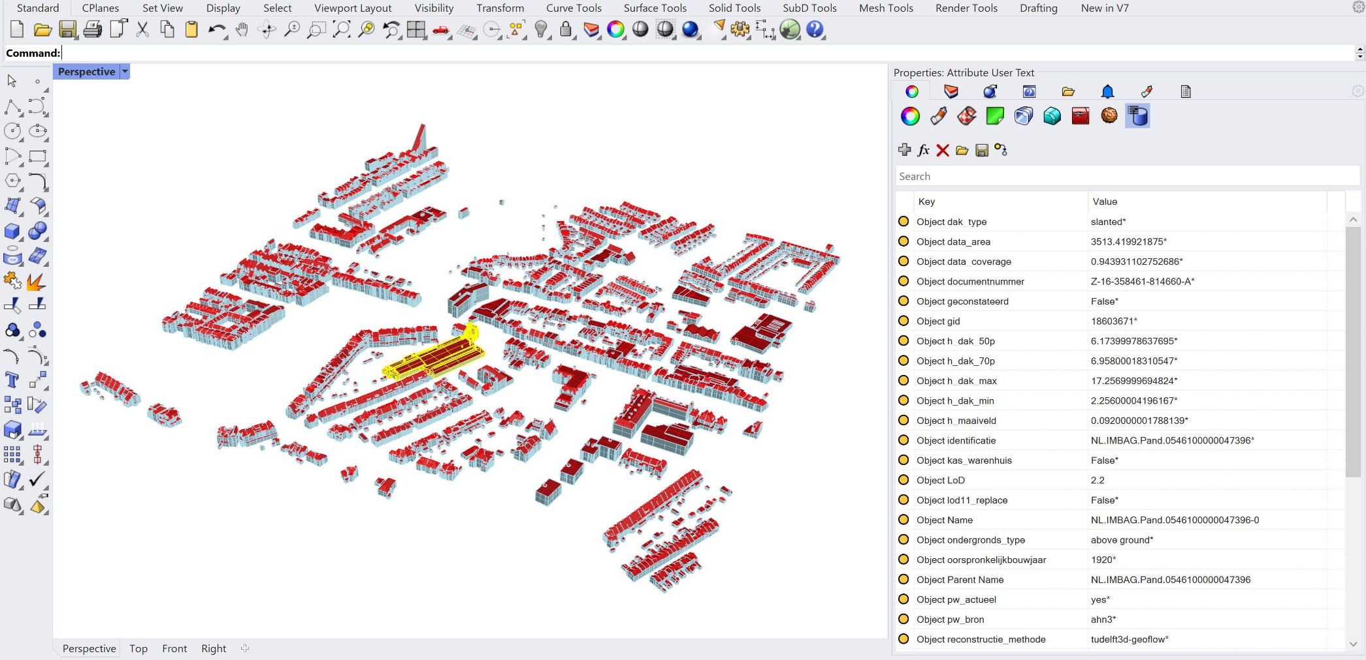
Basic Scripting
09-10-2020
Notes:
. If we isolate the LoD2.2 layer and select an object, we can see that not only the layers contain some semantic data, but also the objects itself. Anything from IDs, document numbers, construction years it is all there.

Slide 7
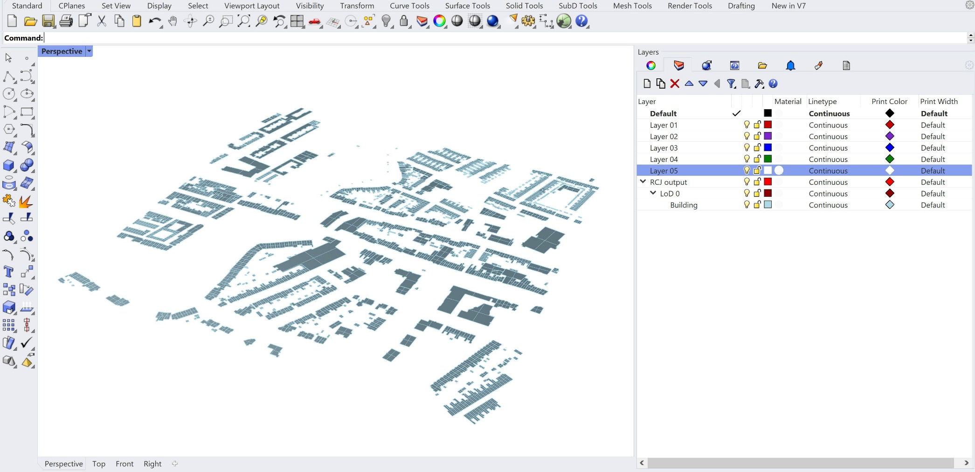
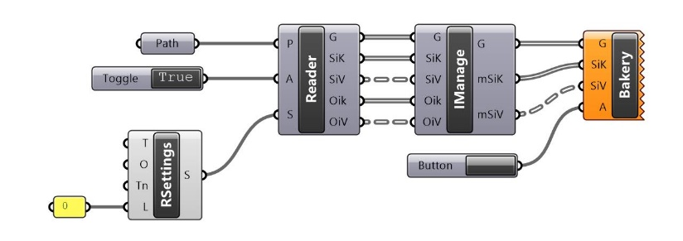
Basic Scripting
09-10-2020
Notes:
All these LoDs might not be needed for the processes which are desired by the user, so with the addition of another RhinoCityJSON component a desired LoD can be isolated directly in grasshopper. If only the LoD 0 objects are needed, they can be filtered out like this. Any LoD can be filtered in this manner, and for the BAG data there is no need to worry about losing attributes and data due to every object inheriting information from their parent object. So even when the parent object is not loaded into rhino the data will still be present.
This is still a fairly easy script, and only using a subset of the available components supplied by the developed plugin. So, what could more advanced scripts do? And, the sky is really the limit here. The data is not only exposed in rhino after baking, but is also already exposed in grasshopper itself, and this done in a format that makes it very easy to work with the data with other grasshopper components. We are not talking about only components from this plugin, but also native components and components from other plugins.

Slide 8
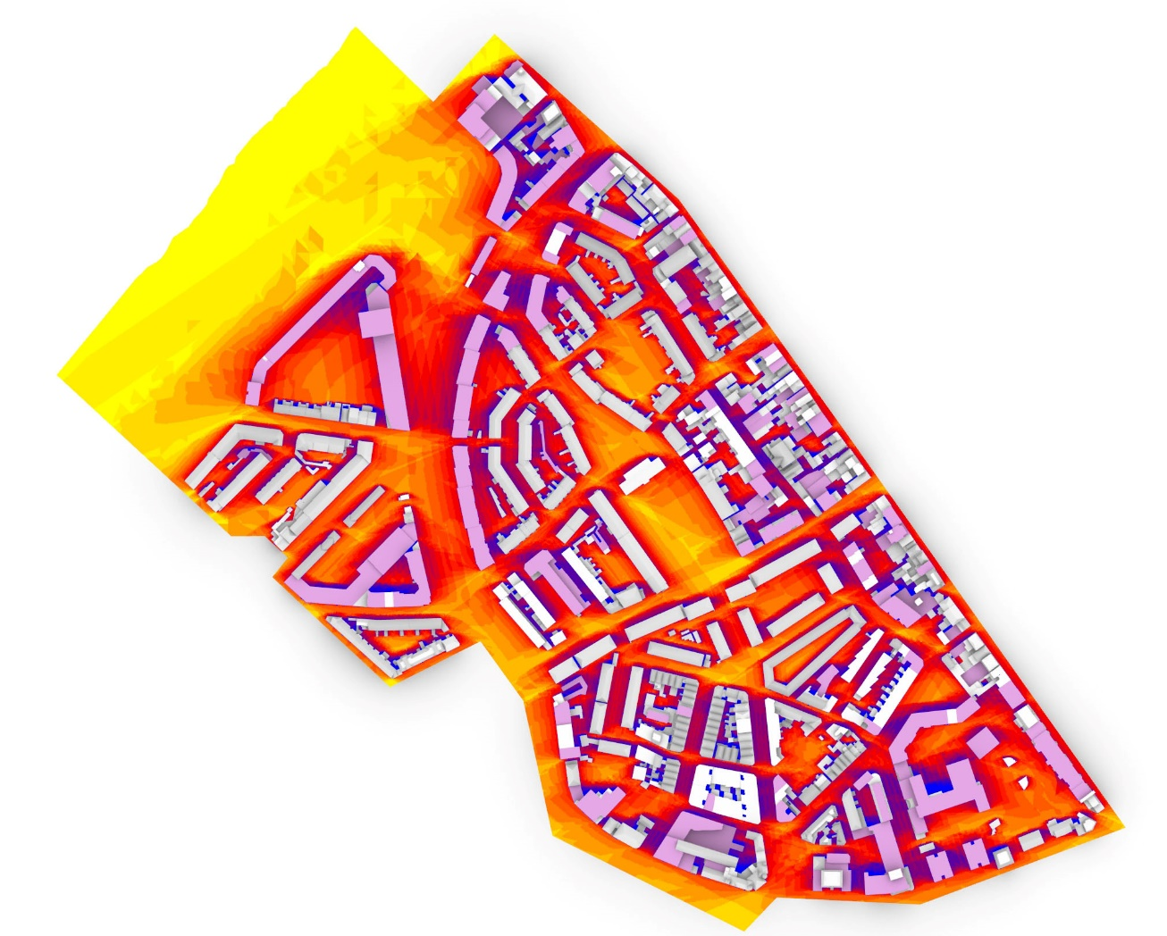
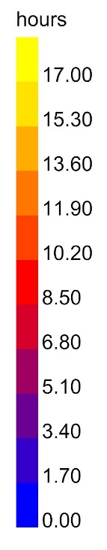

Advanced Scripting
Heightened building
Top view of a CityJSON model depicting the hague. 24hr Solar analysis of the 21st of June. Flat rooved buildings have been heightened by 4 meters
09-10-2020
Notes:
An example of using native components would be adding an area value attribute to every roof surface. And by using a plugin like ladybug a user could evaluate what the effects are of adding another floor, to only the flat roofed buildings, on the sunlight reaching the ground.

Slide 9
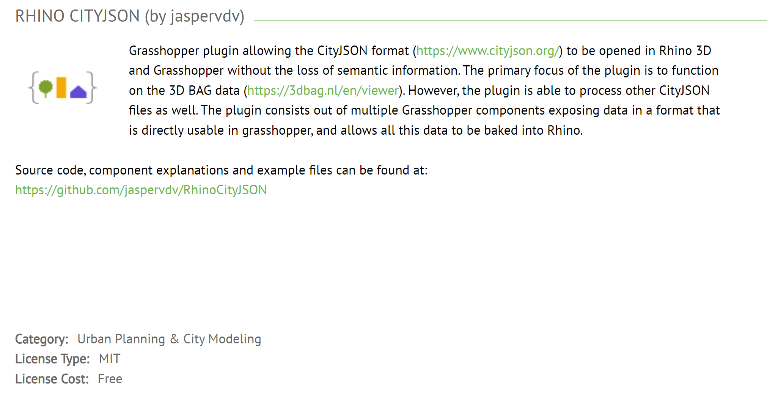
Acquiring the plugin
09-10-2020
Notes:
The plugin is available from a couple of sources. One of which is Food4Rhino. Just typing CityJSON in the search bar will return the plugin as top result. From Food4Rhino a stable version of the plugin can be downloaded. The download has some examples included. However

Slide 10
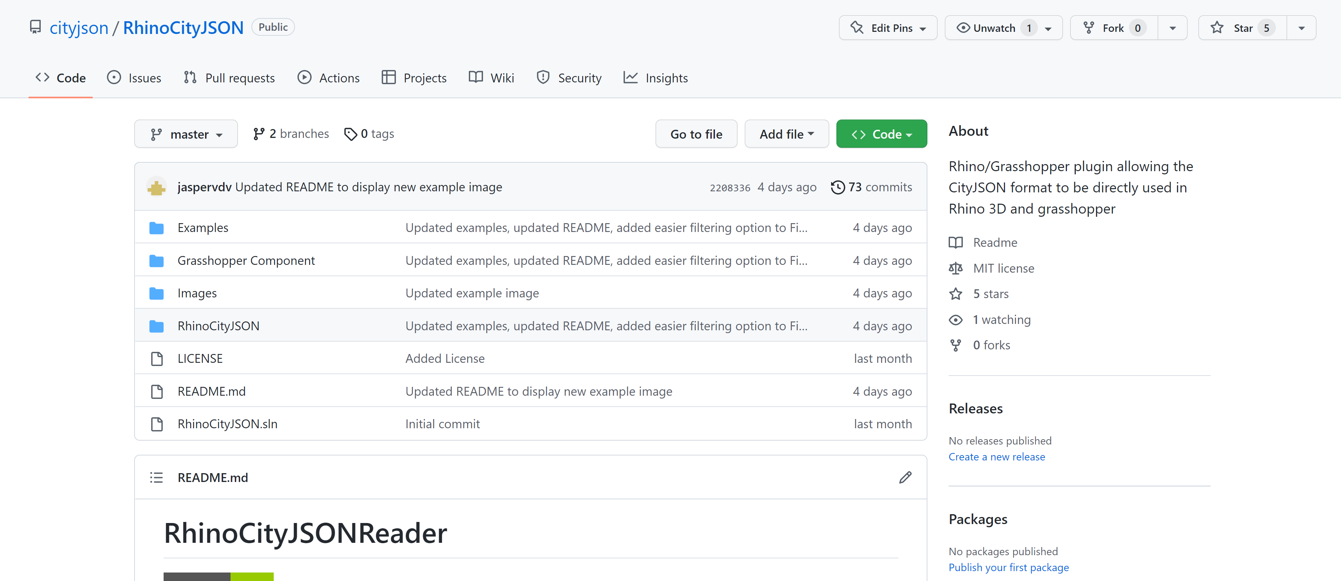
Acquiring the plugin
09-10-2020
Notes:
the code is also open source, so on github the source code can be found. This means that anyone can add to, or change the components’ code. The plugin is still actively being developed, so not everything is properly supported yet. The github repository is more often updated than the Food4Rhino page. But, we are not all programmers, so if you would just like a more regularly updated version of the plugin, you can find a prebuild version here as well. Just note that this is often more experimental so it could be more crash and error prone.

Slide 11
RhinoCityJSON
Rhino/Grasshopper plugin allowing the CityJSON format to be directly used in Rhino 3D and grasshopper
Jasper van der Vaart / 17-11-2022

